Slide 1
<ULTFIT>
ULTimate outFIT
30 愛心貓貓 蔡忠紘、黃文璁、陳曦、許天鈞

Slide 2
Motivation
顧客角度
商家角度
<ULTFIT> 角度
面對眾多 選項難以抉擇
難以針對 顧客需求客製化 庫存管理、商品輸送效率低
提供社群整合方案 降低資訊不對稱

Slide 3

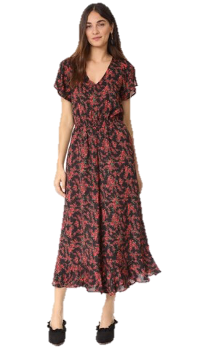

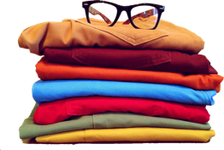
Workflow
Social Network Integration
Outfit
Recommandation
Style
Encoding

Slide 4
Userflow
1
2
3
4
臉部辨識登入
根據社群追蹤 風格搭配多種組合
智慧倉儲系統
結帳後記錄喜好

Slide 5

Awesome features
Instagram-based recommendation system
Fine-tune prediction based on feedbacks
Smarter product management system
Face Recognition for members

Slide 6
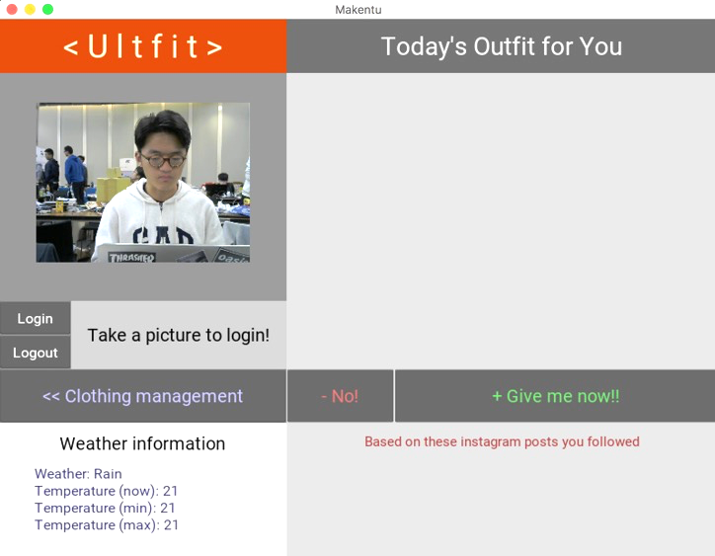
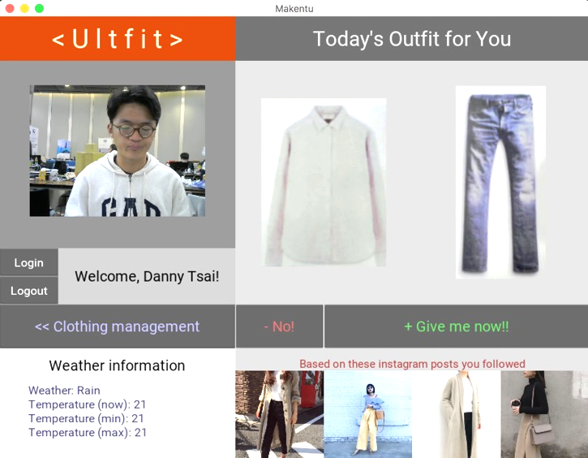
Person Identification
Member identification based on Azure Face API

Slide 7

Social Network Integration
Recommendation based on Instagram you follow
Recommended outfit
<ULTFIT>
Instagram posts

Slide 8

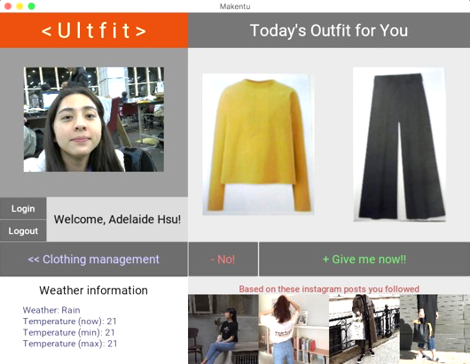
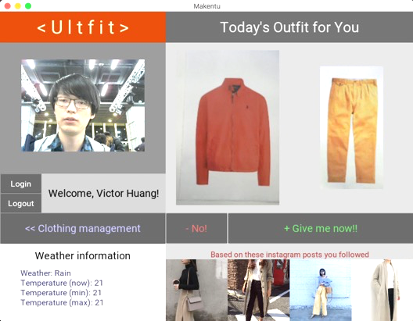
Personalized recommendation
Different recommendation for different customers!
Member 1
Member 2
Member 3

Slide 9
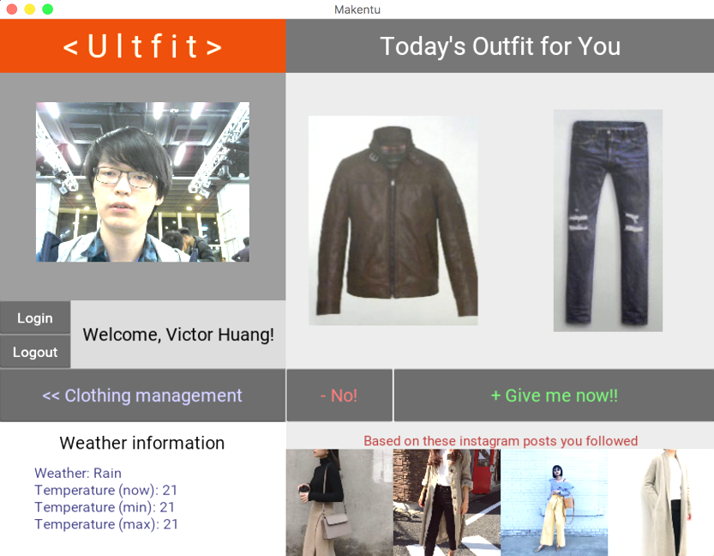
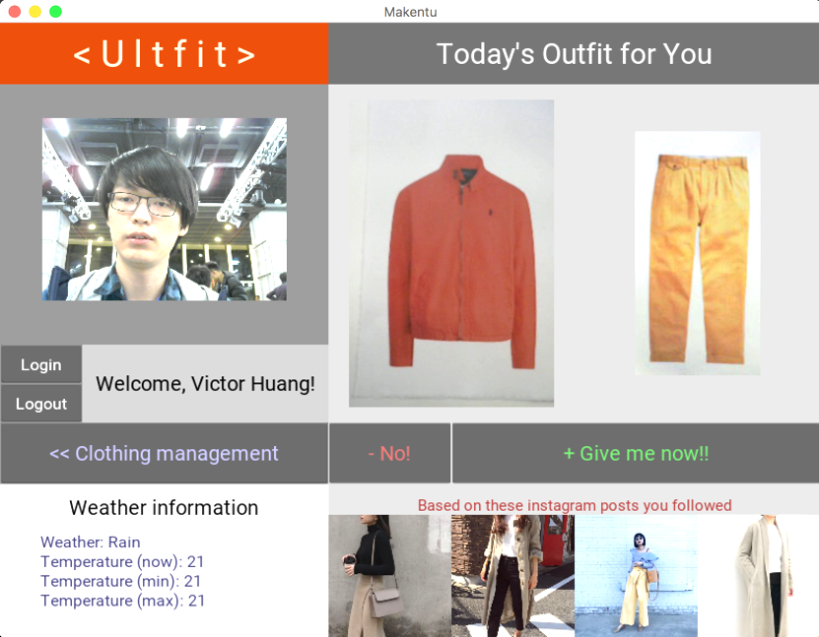
Adapting to your style
The system will learn your preference for the future!
<ULTFIT>
Don’t like this ?
We prepared other choices for you!
Next time we’ll do better

Slide 10
Customer-side Demo

Slide 11
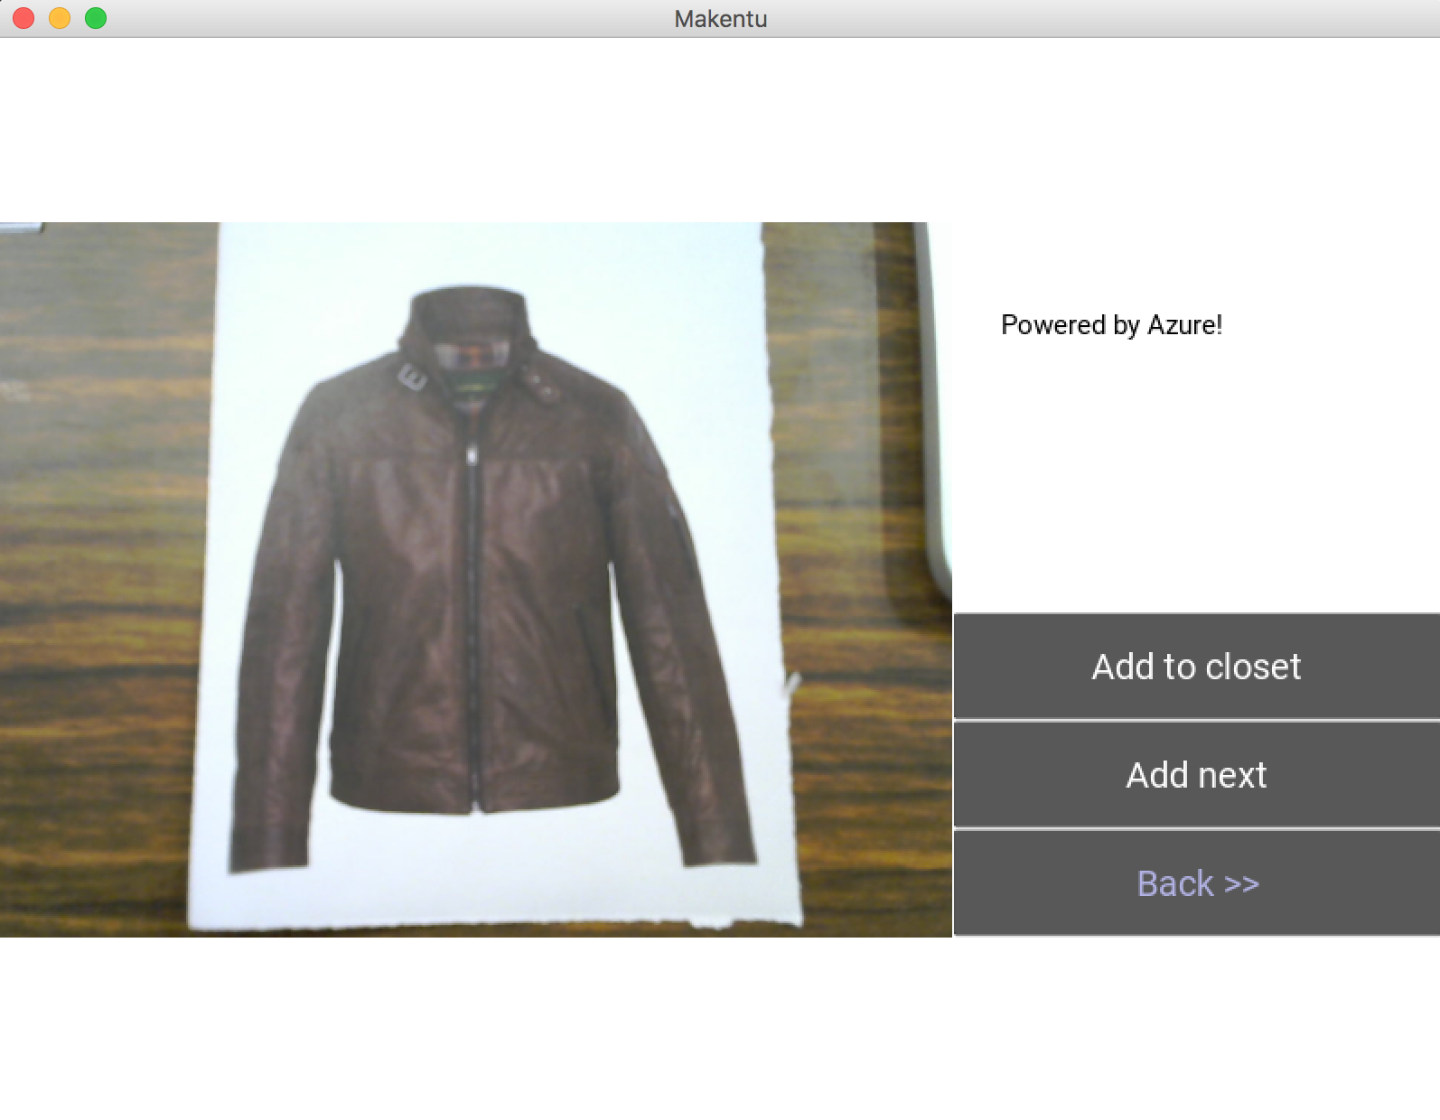
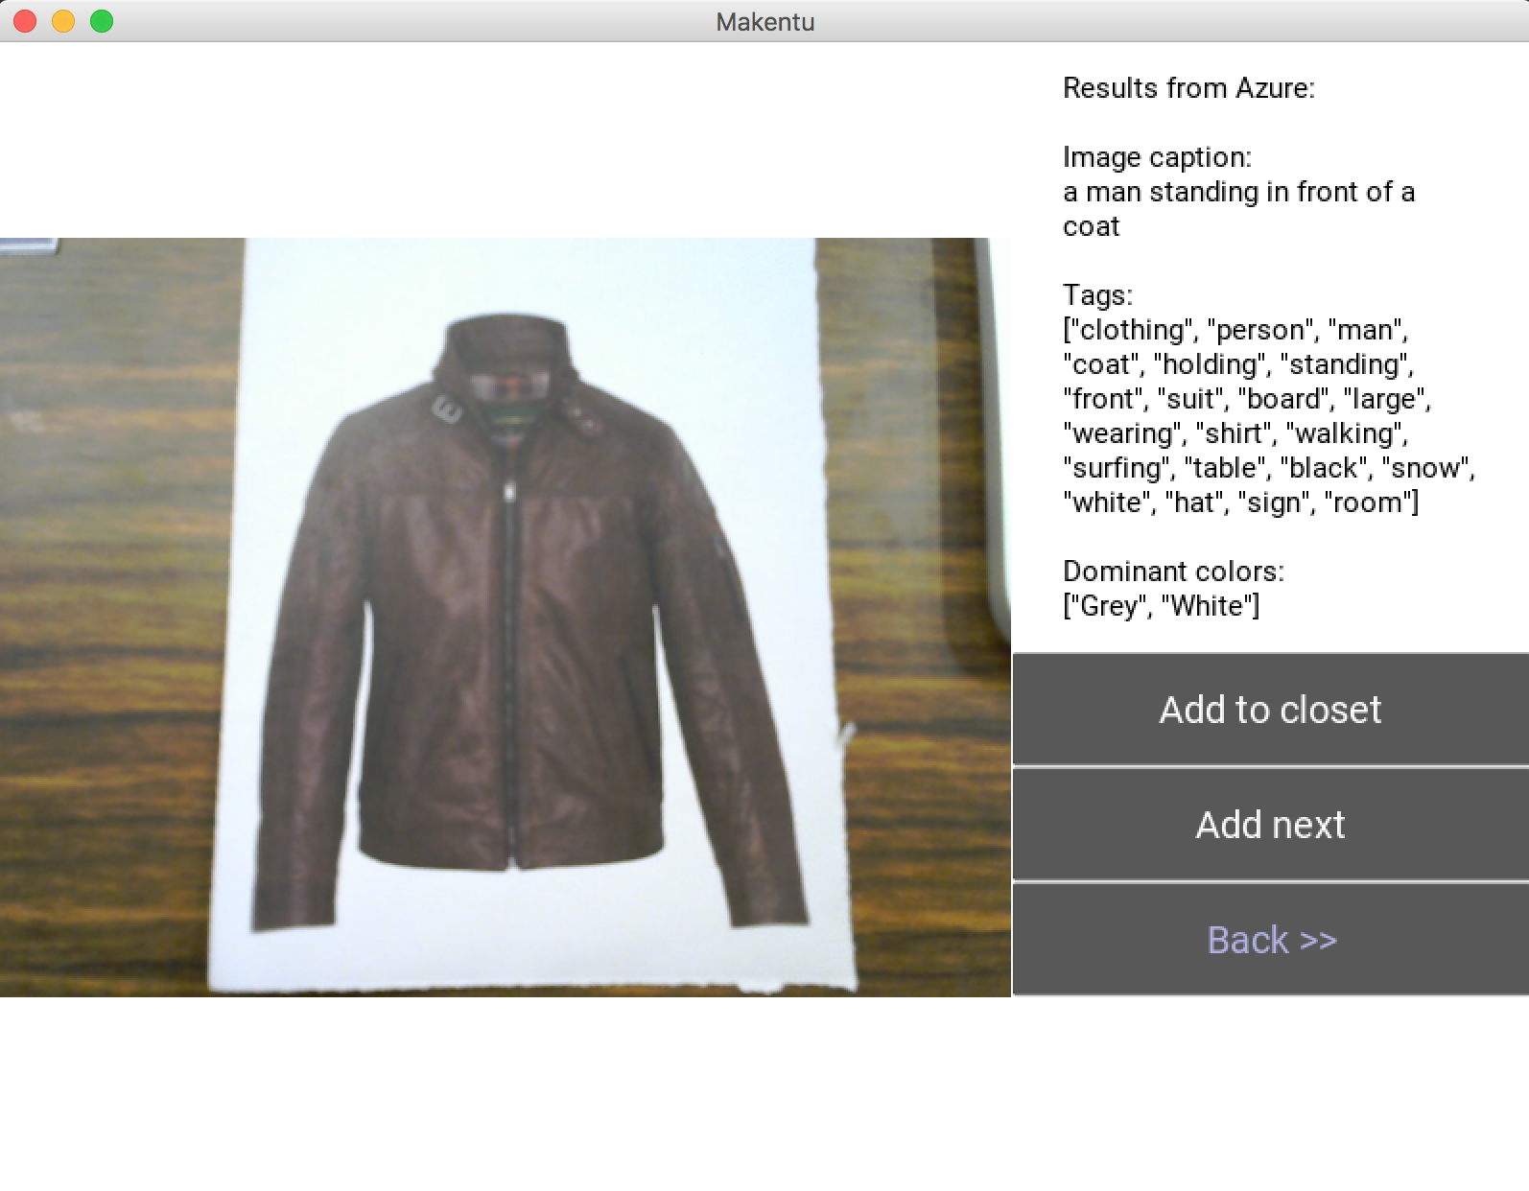
Smarter management system
Using Azure Computer Vision API to help the owners

Slide 12
Owner-side Demo

